Slide 1
Chickens and Eggs: Recurrence Quantification Analysis
Barney Ricca
Notes:
Link to Zip file:
https://raw.githubusercontent.com/barneyricca/SCIPIE2021/main/RQA%20Workshop.Rmd

Slide 2
Outline
Introduction (5 minutes)
What is Recurrence? (20 minutes)
Recurrence Quantification Analysis (25 minutes)
Categorical data
Continuous data
Extensions (5 minutes)
Data work (30 minutes)
Closing Discussion (5 minutes)

Slide 3
Me
Research Associate Professor (Statistics) for the Lyda Hill Institute for Human Resilience (University of Colorado Colorado Spring).
Previously, faculty member in statistics/data science, faculty member in STEM education, secondary teacher, faculty member in physics
English education, complexity in education, pharmacy education, program evaluation, musical instruments
Nonlinear for almost 40 years

Slide 4
Installing R & RStudio
Google “download r statistics” + Windows or Mac
Download
Install
Google “download rstudio”
Get the proper free version (Mac or Windows)
Install
Yours will probably look a bit different than mine
Dark vs. light background
Position of “panes”

Slide 5
What is Recurrence?

Slide 6
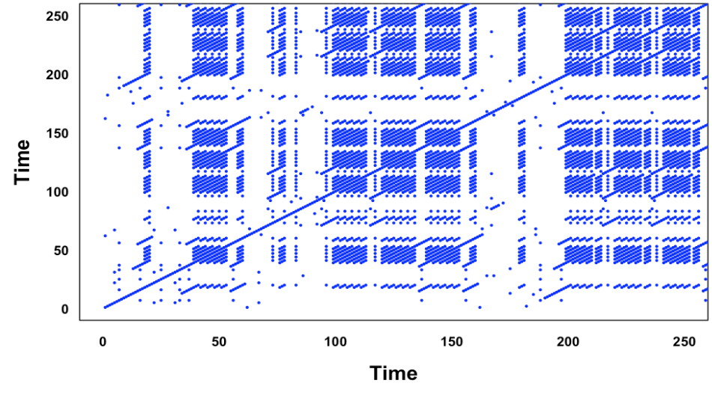
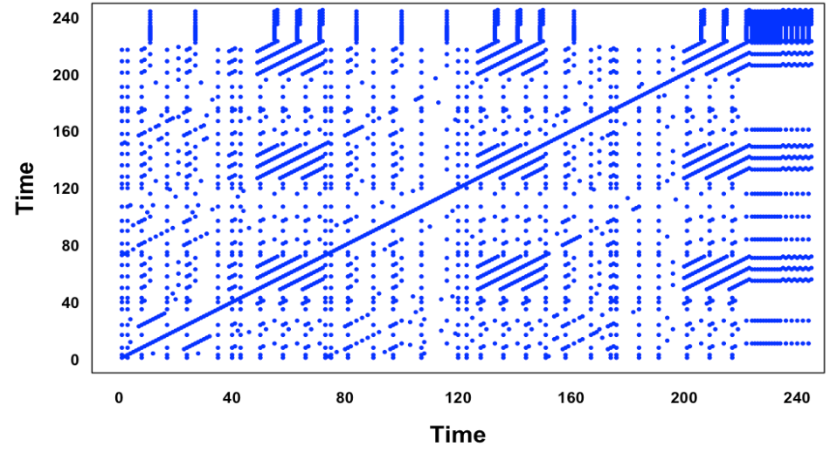
Compare these plots

Slide 7
Compare these plots
Beatles’ “Let It Be”
Beatles’ “Revolution”

Slide 8
Recurrence Plots
Plot the time series on each axis
Put a point where there is a “recurrence”
The same (quantitative data: close-enough) value on the x- and y-axes
Characteristics
Diagonal line segments: recurring patterns (parallel to line of identity (LOI)) or palindrome patterns (perpendicular to LOI)
Vertical and/or horizontal lines: stuck-ness
Blocks (with jagged edges): multiple consecutive recurrences
Density of points: higher density corresponds roughly to relatively fewer unique values (e.g., low entropy) or more constrained dynamics (e.g., low entropy again)
Homogeneity: meso-scale patterns/dynamics (e.g., units of analyses)
Periodic patterns
White bands: random data / unique values
Isolated points: random dynamics dominate
Others that make sense only with numerical data

Slide 9
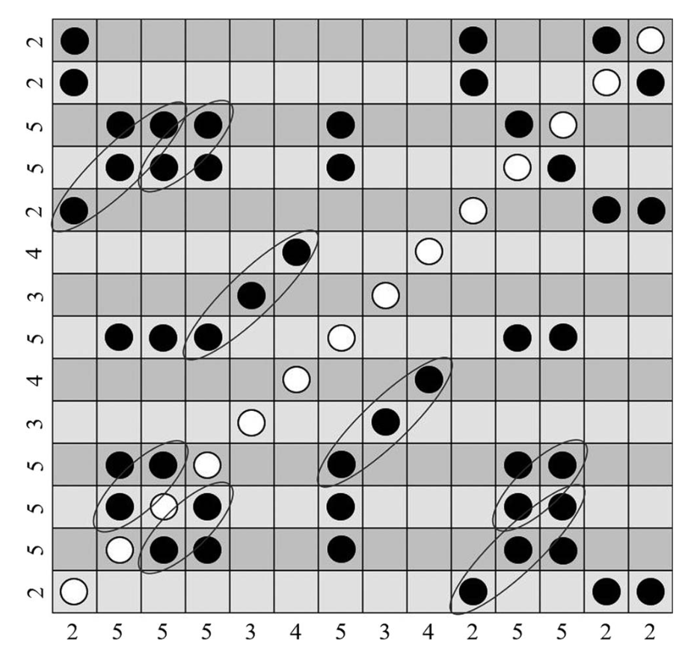
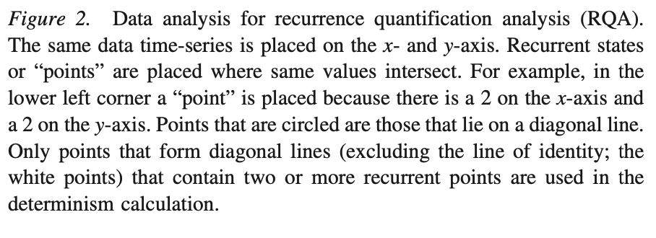
Recurrence (via Jenkins, 2020)

Slide 10
Recurrence Quantification Analysis
Quantify what we just saw

Slide 11
Diagonal Lines (parallel to LOI)
Deterministic Structures
Or chimera
Repeating from time to time
Determinism either internal or external
Exist for some time; length of time is length of the line
Metric: DET
Proportion of recurrent points forming diagonal lines
Works in concert with the recurrence rate (RR), which is the proportion of recurrent points in the plot
Examples: Choruses in Let It Be and Revolution RP

Slide 12
Compare these plots
Beatles’ “Let It Be”
Beatles’ “Revolution”

Slide 13
Diagonal Lines (perpendicular to LOI)
Palindromic in time
No standard metric
Not something you’ll see a lot, probably
Strict sinusoidal relationships (or linear combinations of those) will demonstrate this

Slide 14
Vertical or Horizontal Lines
State does not change
Stuck-ness
Metrics:
LAM: proportion of vertical lines
TT: Average length of those lines
Example: The top and right side of the Revolution RP

Slide 15
Compare these plots
Beatles’ “Let It Be”
Beatles’ “Revolution”

Slide 16
Blocks
Solid blocks
Stuck for a long time
Example: End of Revolution (top right corner)
Not-quite-solid blocks
Diagonal stripes
Repeated sequences
Example: “let it be, let it be, let it be”

Slide 17
Compare these plots
Beatles’ “Let It Be”
Beatles’ “Revolution”

Slide 18
Density of Points
Recurrence rate (RR)
Impacted by choice of radius!
We’ll talk about radius soon
Typically, advise is <10%
Adjust radius to be in this range

Slide 19
Compare these plots
Beatles’ “Let It Be”
Beatles’ “Revolution”

Slide 20
Entropy
A measure of surprise
How much information is in each data point (on average)
Less surprise, less entropy
Fewer options to choose from
More regular pattern of data
ENTR
Entropy of diagonal lines longer than the threshold parameter, mindiagline
nENTR
Longer sequences have more “Shannon entropy” so nENTR normalizes the entropy by dividing by the number of data points

Slide 21
Compare these plots
Beatles’ “Let It Be”
Beatles’ “Revolution”

Slide 22
Homogeneity
Pattern seems the same over large blocks
Statistically similar, not exactly the same
E.g., all red oak trees are statistically similar
Indicates stationary dynamics
Phase identification!
Diagonal white bands
Transitions between phases
Vertical White bands
Stochastic, random (“fluctuation”) dynamics
A relatively few, isolated points

Slide 23
Compare these plots
Beatles’ “Let It Be”
Beatles’ “Revolution”

Slide 24
Periodic patterns
Periodically repeating dynamics
Sensitive to radius choice

Slide 25
Compare these plots
Beatles’ “Let It Be”
Beatles’ “Revolution”

Slide 26
Continuous Data: State Space
Extra complications and extra insight

Slide 27
State Space
State: Measurements that define a system
Weather: temperature, pressure, humidity
Health: Blood pressure, BMI, pulse
Any set of numbers work
Whether the chosen state variables of a system form an appropriate characterization of the system or not is a thorny question

Slide 28
State Space with Multidimensional Data
Each data stream gets its own axis
“Parameterized” (by time) curve
Normalization often helpful
Classic example: Lorenz equations for weather
3 coupled equations
In case you care: rate of convection, horizontal temperature variation, vertical temperature variation
Butterfly effect

Slide 29
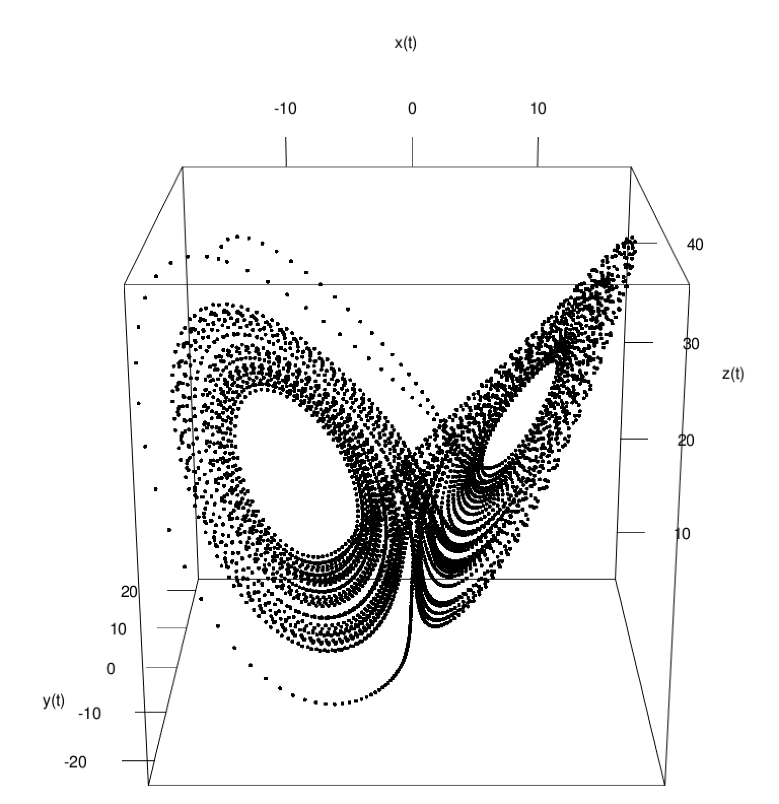
Lorenz Butterfly

Slide 30
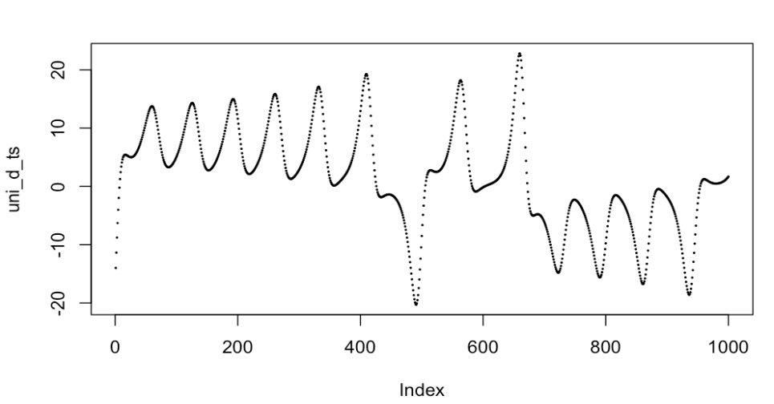
Single Data Stream
Horizontal temperature variation in Lorenz: One dimension
It’s easier to deal with than the other two variables
Embedding can approximately recover the full dynamics
If you don’t fully know the dynamics of a system, this can help

Slide 31
Embedding and Delay
Skip the mathematical details
The process:
Find an appropriate delay to use
Mutual information or autocorrelation
Find an appropriate dimension to use
What are found are upper bounds to the delay and embedding dimension
Some further playing around may be necessary

Slide 32
Embedded Series
For the horizontal temperature variation of Lorenz
Delay
Autocorrelation: 162
Too big to work in memory
Mutual Information: 17
Some playing around (working down from 17): 8
Embedding dimension: 3
Plot it!

Slide 33
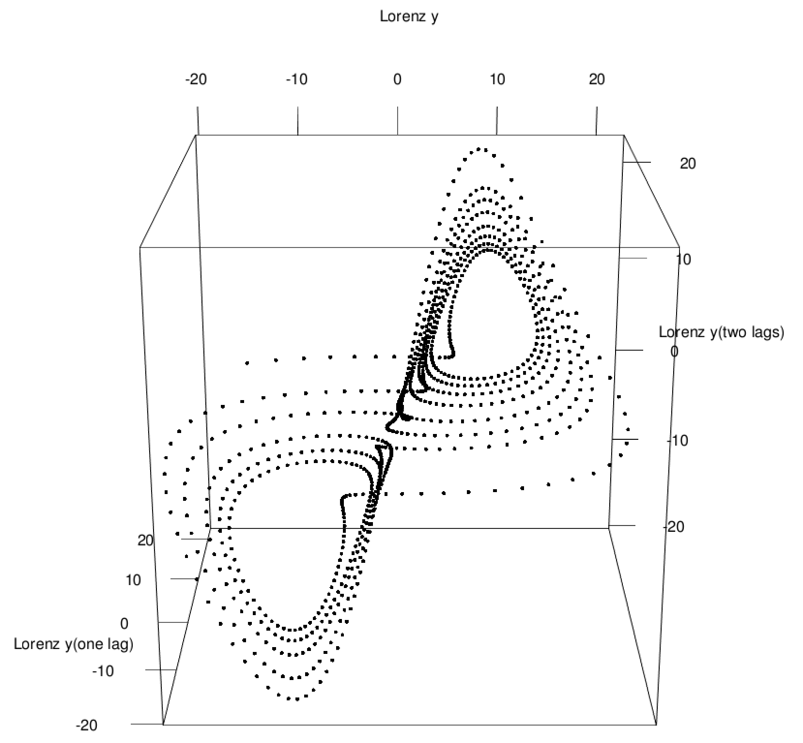
Reconstructed Lorenz plot

Slide 34
Embedding Unidimensional Data Result
Even a unidimensional stream of data may reflect higher-dimension dynamics!
There are ways to find an appropriate embedding dimension and delay
Not clear if the current methods are optimal, but they work reasonably well
For this workshop, we don’t care about the details
There are functions in R that will help
They give values that are the upper bound (i.e., may be too high) for the delay and the embedding dimension
Hence, find the delay and embedding dimension, and work your way down

Slide 35
Radius: How close is close?
Continuous data won’t be exactly equal
Choose how close is close
A.k.a., the “radius”
Trial and error, generally: Choose a value that brings insight

Slide 36
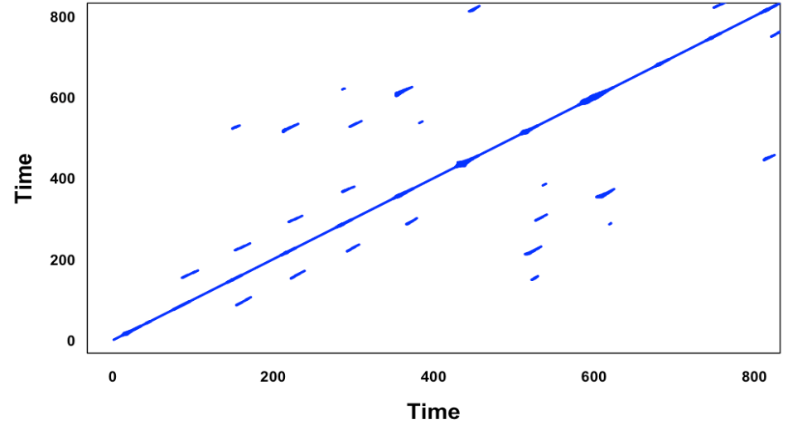
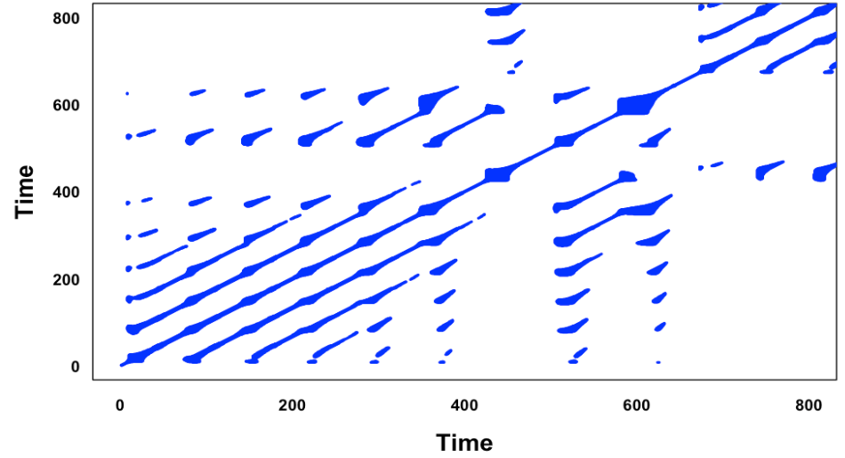
Radius example
Radius = 0.01
Radius = 0.05

Slide 37
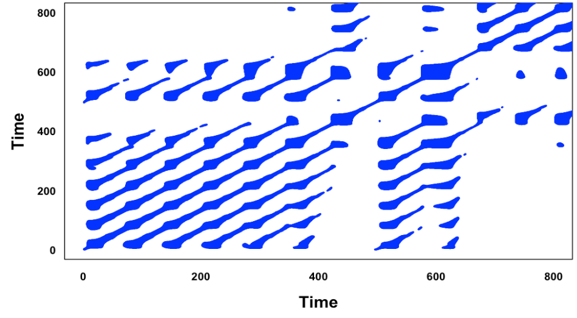
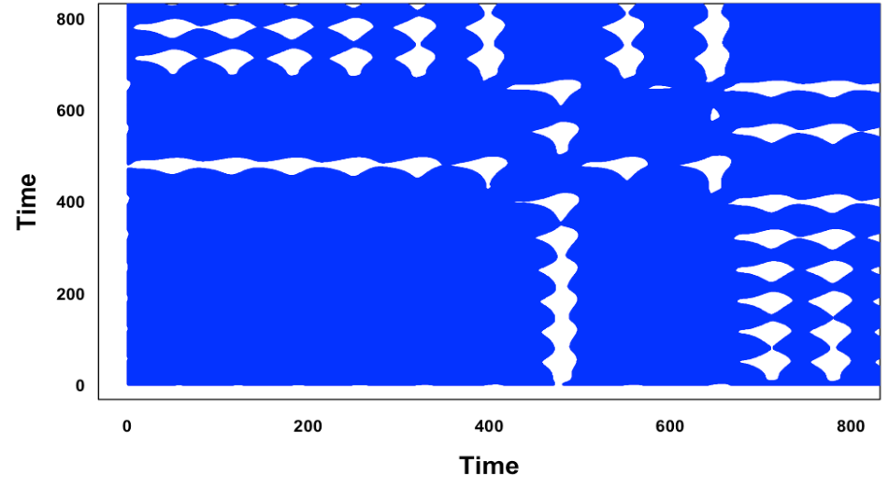
Radius example (continued)
Radius = 0.1
Radius = 0.5

Slide 38
Asides
Aside #1
Topological data analysis probably will help here, but I haven’t seen it done yet.
I’m not positive about my own playing around meaning anything yet
Stay tuned, I guess
Aside #2
Answer: Sure, you can embed categorical data
Probably don’t get anything
Embedding depends on false-nearest neighbors
Categorical data aren’t “near” each other in any meaningful way
You’ll probably have to do something different

Slide 39
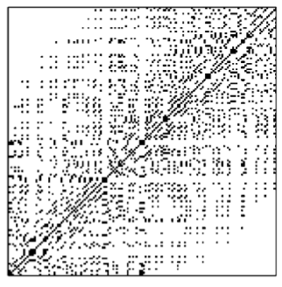
Fading and Darkening
Drift of dynamics
Example from Marwan (2007)
Look at corners

Slide 40
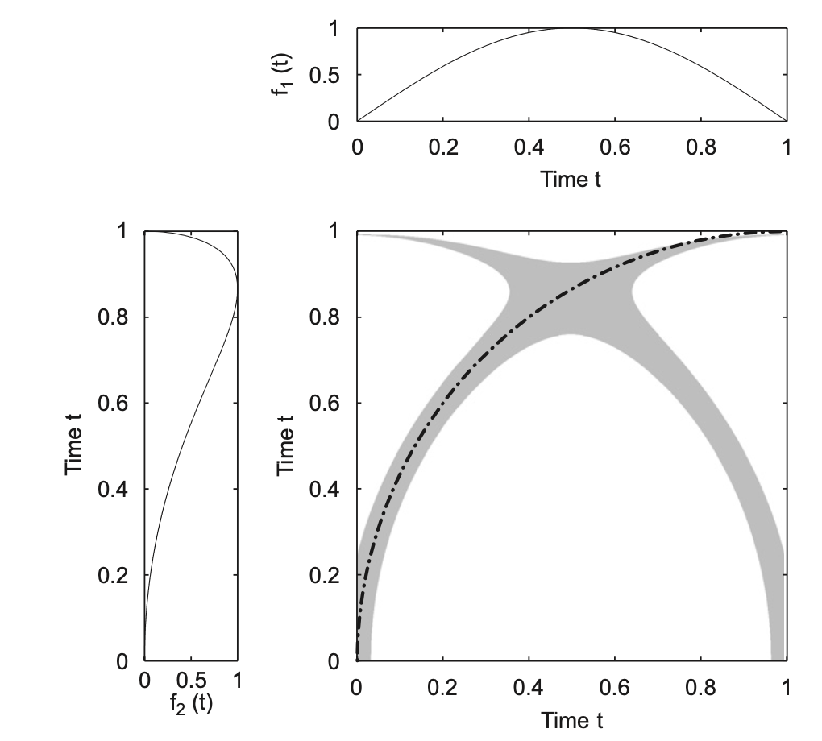
Curves
Some distortion (e.g., slowing down) of dynamics
Example from Marwan (2007)

Slide 41
Extensions

Slide 42
Cross Recurrence Quantification Analysis
Compare two (or more) data streams
No longer symmetric about LOI
One or the other stream could lead and lag the other
Fed: Interest rates and inflation
Turns out not to be true
Home: Outside temperature and heater/air conditioner
Same function in R
Use two streams, not one
Change method from ‘rqa’ to ‘crqa’

Slide 43
Significance
Significance and significant differences, etc. are all done by bootstrapping approaches
Too much for a workshop of this length, though…

Slide 44
Data Work
Notes:
Quick poll: Who has data? Who doesn’t?

Slide 45
Data Prep
RQA
Data should be a single column
Text can be processed to this form
Text can be a pain, but there are standard techniques that cover most of the pain
Some of this is in the script
CRQA
Multiple columns of the same length

Slide 46
To the R-Cave!
R script and data download from GitHub
Link in the chat
Data (for those who need it) in the script
Categorical
Or you could write something, or get some lyrics, or whatever
Numerical
Two (numerical) series
I’ll answer questions
Put a question in the chat, and I’ll come by to help out
I.e., I’ll answer it in the Zoom

Slide 47
References
Some reasonable references
Guevara, M., Cox, R., van Dijk, M., & van Geert, P. (n.d.). Attractor dynamics of dyadic interaction: A recurrence based analysis. Nonlinear Dynamics, Psychology, and Life Sciences, 21(3), 289–317.
Jenkins, B. N., Hunter, J. F., Richardson, M. J., Conner, T. S., & Pressman, S. D. (2020). Affect variability and predictability: Using recurrence quantification analysis to better understand how the dynamics of affect relate to health. Emotion, 20(3), 391–402. DOI: 10.1037/emo0000556
Marwan, N., Carmenromano, M., Thiel, M., & Kurths, J. (2007). Recurrence plots for the analysis of complex systems. Physics Reports, 438(5–6), 237–329. https://doi.org/10.1016/j.physrep.2006.11.001
Marwan, N., & Webber, C. L. (2015). Mathematical and Computational Foundations of Recurrence Quantifications. In C. L. Webber, & N. Marwan (Eds.), Recurrence Quantification Analysis (pp. 3–43). Springer International Publishing. DOI: 10.1007/978-3-319-07155-8_1
Fusaroli, R., Konvalinka, I., & Wallot, S. (2014). Analyzing Social Interactions: The Promises and Challenges of Using Cross Recurrence Quantification Analysis. In N. Marwan, M. Riley, A. Giuliani, & C. L. Webber, (Eds.), Translational Recurrences (Vol. 103, pp. 137–155). Springer International Publishing. DOI: 10.1007/978-3-319-09531-8_9

Slide 48
Discussion

